Slide 1
WELCOME !
Ec.PhD, Eng.PhD, ASSOCIATE PROFESSOR
Mircea Aurel NIŢĂ
The National University of Political and Administrative Studies
Faculty of Public Administration, Bucharest, Romania

Slide 2
The National University of Political and Administrative Studies
Faculty of Public Administration, Bucharest, Romania
KNOWLEDGE MANAGEMENT: DEVELOPING THE NEW TYPES
OF INTELLIGENCE
EVOLUTION IN HIGH EDUCATION
AND THE NEW TYPE OF INTELLIGENCE –
SPIRITUAL INTELLIGENCE IN THE MANAGEMENT
OF PRIVATE AND PUBLIC SECTOR -
AUTHOR: Ec.Ph D, Eng.Ph D, ASSOCIATE PROFESSOR
MIRCEA AUREL NIŢĂ

Slide 3
Objectives:
to demonstrate that a new behavior, new attitudes and new way of thinking based on new type of intelligence are the future of the improved leadership and management ,too
to show that a reform of public and private services requires a new strategically leadership oriented to serve the public interest
to emphasize that new spiritual intelligence management can become a tool for telling the truth and not for influencing the truth
to conclude that a new trend in education is necessary, so that the new leadership will be based on new type of intelligence, which means a new type of thinking
AUTHOR: EC.PHD, ENG.PHD, ASSOCIATE PROFESSOR MIRCEA AUREL NIŢĂ

Slide 4
Keywords:
emotional intelligence
new type of spiritual intelligence
transdisciplinarity
levels of reality and levels of operation
multiple perceptions
AUTHOR: EC.PHD, ENG.PHD, ASSOCIATE PROFESSOR MIRCEA AUREL NIŢĂ

Slide 5
Contents:
Introduction
1. The dualism of the mind representation and limits of sensorial perception
2. From one perception to multiple perceptions. Mind who is able to integrate
3. The new mind looking for the third party and focused on three new abilities IHSC
4. Types of intelligence and the new intelligence
5. The spiritual intelligence or the competence to give and
share (SQ). Concept
6. The spiritual leader or leader in the service of others
7. New education and UN
8. Practical application - spiritual intelligence test
Conclusions
AUTHOR: EC.PHD, ENG.PHD, ASSOCIATE PROFESSOR MIRCEA AUREL NIŢĂ

Slide 6
INTRODUCTION
Why this paper?
mind representations are set up by our own experience, emotions, feelings and, of course, by our intellectual knowledge
human mind is working with different types of truth which influence the results of reality evaluation from any mind
brain with his both hemispheres suffers a dynamic change of the functioning
new type of intelligence-the new intelligence, quantic intelligence or spiritual intelligence - type of intelligence that a graduater of our faculty and a leader of a county, region or local community must have in the future
AUTHOR: EC.PHD, ENG.PHD, ASSOCIATE PROFESSOR MIRCEA AUREL NIŢĂ

Slide 7
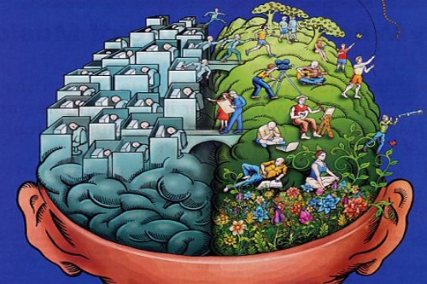
1. THE DUALISM OF THE MIND REPRESENTATION AND LIMITS OF SENSORIAL PERCEPTION
ONE MIND...
ONE BRAIN...
TWO HEMISPHERES
?
AUTHOR: EC.PHD, ENG.PHD, ASSOCIATE PROFESSOR MIRCEA AUREL NIŢĂ

Slide 8
1. THE DUALISM OF THE MIND REPRESENTATION AND LIMITS OF SENSORIAL PERCEPTION
The left side is associated with intellect,
and is in relationship with convergent, abstract, analytic, calculated, linear, sequencial and objective thinking;
it is focused on details and “splits hairs”.
This component produces direct, vertical, sensible, realistic, cool, powerful and dominant thoughts.
AUTHOR: EC.PHD, ENG.PHD, ASSOCIATE PROFESSOR MIRCEA AUREL NIŢĂ

Slide 9
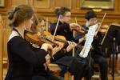
1. THE DUALISM OF THE MIND REPRESENTATION AND LIMITS OF SENSORIAL PERCEPTION
The right side is associated with intuition,
and is in relationship with divergent, imaginative,
metaphorical, unlinear, subjective thinking;
it is focused on the whole thing.
This component produces flexible, diverse,
complex, visual,
diagonal, mystic and submissive thoughts.
AUTHOR: EC.PHD, ENG.PHD, ASSOCIATE PROFESSOR MIRCEA AUREL NIŢĂ

Slide 10
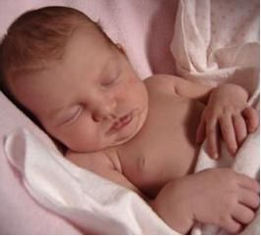
1. THE DUALISM OF THE MIND REPRESENTATION AND LIMITS OF SENSORIAL PERCEPTION
THE RATIO BETWEEN INDIVIDUAL MIND AND COLLECTIVE MIND-movie 1
The first stage
the domination of the collective mind against individual mind
AUTHOR: EC.PHD, ENG.PHD, ASSOCIATE PROFESSOR MIRCEA AUREL NIŢĂ

Slide 11
1. THE DUALISM OF THE MIND REPRESENTATION AND LIMITS OF SENSORIAL PERCEPTION
THE RATIO BETWEEN INDIVIDUAL MIND AND COLLECTIVE MIND
COLLECTIVE MIND AND THE DUALISM OF THE MIND
tall
small
warm
cold
fat
slim
modest
proud
opened
closed
AUTHOR: EC.PHD, ENG.PHD, ASSOCIATE PROFESSOR MIRCEA AUREL NIŢĂ

Slide 12
1. THE DUALISM OF THE MIND REPRESENTATION AND LIMITS OF SENSORIAL PERCEPTION
THE RATIO BETWEEN INDIVIDUAL MIND AND COLLECTIVE MIND
The second stage
synchronously or not synchronously between individual mind and collective mind
established in time of growing the power of discernment - the first appearance of the free will, full of awareness
Awareness is a mix between attention and lucidity, and the full awareness is 100 % attention, 100% power of concentration plus 100% lucidity – ZERO point after Gregg Braden and not only.
AUTHOR: EC.PHD, ENG.PHD, ASSOCIATE PROFESSOR MIRCEA AUREL NIŢĂ

Slide 13
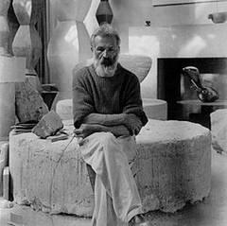
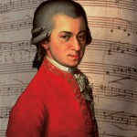
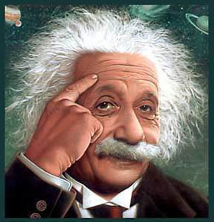
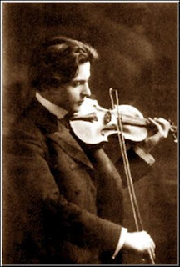
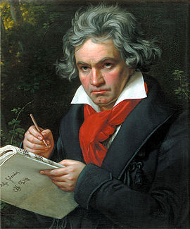
1. THE DUALISM OF THE MIND REPRESENTATION AND LIMITS OF SENSORIAL PERCEPTION
THE RATIO BETWEEN INDIVIDUAL MIND AND COLLECTIVE MIND
The third stage
based on the transcendence of the individual mind beyond the collective mind
the mind of pioneers and geniuses
AUTHOR: EC.PHD, ENG.PHD, ASSOCIATE PROFESSOR MIRCEA AUREL NIŢĂ

Slide 14
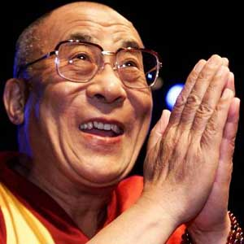
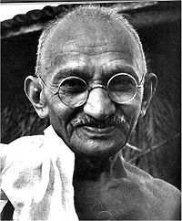
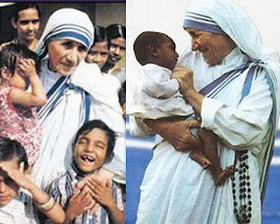
1. THE DUALISM OF THE MIND REPRESENTATION AND LIMITS OF SENSORIAL PERCEPTION
THE RATIO BETWEEN INDIVIDUAL MIND AND COLLECTIVE MIND
The third stage
The quantum intelligence
AUTHOR: EC.PHD, ENG.PHD, ASSOCIATE PROFESSOR MIRCEA AUREL NIŢĂ

Slide 15
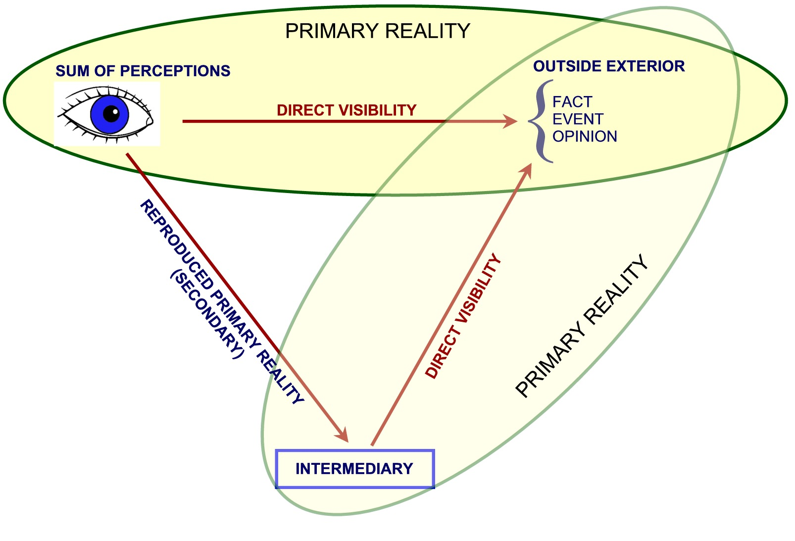
2. FROM ONE PERCEPTION TO MULTIPLE PERCEPTIONS.
MIND WHO IS ABLE TO INTEGRATE
RUDOLPH CARNAP’S PARADOX - movie 2
Fig. no. 1 – The representation of visibilities and types of reality
AUTHOR: EC.PHD, ENG.PHD, ASSOCIATE PROFESSOR MIRCEA AUREL NIŢĂ

Slide 16
RUDOLPH CARNAP’S PARADOX
LIMITS OF KNOWLEDGE:
the mind is preferentially analytical according to the mental representations, only as a result of a way of thinking which is linear, uniform and unitary in the studied sciences
the mind separates, then compares, and finally it analyzes in a way specific to each specialization and profession
they are what they think and they analyze a reality only according to the particular way of thinking, only according to a mental soft accumulated either from previous experience, either from the knowledge gained formally or informally in schools, universities etc.
they operate with what is now defined as partial truths of medical truth, legal truth, journalistic truth, economical truth etc.
they are all right, but, at the same time, they are all wrong
AUTHOR: EC.PHD, ENG.PHD, ASSOCIATE PROFESSOR MIRCEA AUREL NIŢĂ

Slide 17
RUDOLPH CARNAP’S PARADOX
THE SOLUTION is IHSC:
The human mind must Integrate the truths (economic, legal, medical etc), more exactly the different perceptions of different persons and its own perception, Harmonizing them afterwards at an intrapsychic level, but also at the level of the individuals, and in the end to check whether the process has ensured or not the Self-Coherence!
AUTHOR: EC.PHD, ENG.PHD, ASSOCIATE PROFESSOR MIRCEA AUREL NIŢĂ

Slide 18
3. THE NEW MIND LOOKING FOR THE THIRD PARTY AND FOCUSED ON THREE NEW ABILITIES IHSC
PARTIAL TRUTHS
Direct Load
M/I
PD
IN
INTERACTIVE
PP
D
STANDS
TV
ARENA
Football Ground
PP
DV
D
M
C/E
Fig. no. 2 – The representation of marketing and communication media

Slide 19
PARTIAL TRUTHS
E
Direct Load
M/I
PD
IN
INTERACTIVE
PP
D
STANDS
TV
ARENA
Football Ground
PP
DV
D
M
C/E

Slide 20
PARTIAL TRUTHS
E
SL
Direct Load
M/I
PD
IN
INTERACTIVE
PP
D
STANDS
TV
ARENA
Football Ground
PP
DV
D
M
C/E

Slide 21
PARTIAL TRUTHS
E
SL
Direct Load
M/I
PD
P
IN
INTERACTIVE
PP
D
STANDS
TV
ARENA
Football Ground
PP
DV
D
M
C/E

Slide 22
PARTIAL TRUTHS
E
SL
Direct Load
M/I
PD
P
IN
INTERACTIVE
PP
D
STANDS
TV
ARENA
Football Ground
PP
DV
D
DM
M
C/E
I

Slide 23
PARTIAL TRUTHS
E
SL
Direct Load
M/I
PD
P
IN
INTERACTIVE
PP
D
STANDS
TV
ARENA
Football Ground
PP
DV
D
DM
M
C/E
I
L
R
C

Slide 24
PARTIAL TRUTHS
E
SL
Direct Load
M/I
PD
P
IN
INTERACTIVE
PP
D
STANDS
TV
ARENA
Football Ground
PP
DV
D
DM
S
M
C/E
I
T
L
R
C

Slide 25
PARTIAL TRUTHS
E
SL
Direct Load
MM
M/I
PD
P
IN
EC
INTERACTIVE
PP
D
STANDS
TV
ARENA
Football Ground
PP
DV
D
DM
S
M
C/E
I
T
L
R
C

Slide 26
PARTIAL TRUTHS
E
G
SL
Direct Load
MM
M/I
PD
P
IN
EC
INTERACTIVE
PP
D
STANDS
TV
ARENA
Football Ground
PP
DV
D
DM
S
M
C/E
I
T
L
R
C

Slide 27
PARTIAL TRUTHS
EU
E
G
SL
Direct Load
MM
M/I
PD
P
IN
EC
INTERACTIVE
PP
D
STANDS
TV
ARENA
Football Ground
PP
DV
D
DM
S
M
C/E
I
T
L
R
C

Slide 28
INDIRECT
EU
E
G
SL
Direct Load
MM
M/I
PD
P
IN
EC
INTERACTIVE
PP
D
STANDS
TV
ARENA
Football Ground
PP
DV
D
DM
S
M
C/E
I
T
L
R
C
LOAD

Slide 29
INDIRECT
EU
E
G
SL
Direct Load
MM
M/I
PD
P
IN
EC
INTERACTIVE
PP
D
STANDS
TV
ARENA
Football Ground
PP
DV
D
DM
S
M
C/E
I
T
L
R
C
LOAD

Slide 30
Criteria | Types of truths | Characteristics
type of scientific branch or sub-branch | the intellectual partial truths | the truths separated by the mind of each specialists of a scientific branch or sub-branch (judicial, economical, medical, journalism etc.)
adhesion community members | the consensual truth | the truth which gathers the majority of all the members of a human community
 | the contextual truth | truth depends on contextual situation at a time
level of reality in which we operate | dual truth | truth recognized under the influence and at the disposition of the Law of excluded middle
 | trinitarian truth | truth which operates under the influence of Law of included middle (Stefan Lupasco) and which is resulted through the transcendence of the dual truth from A’s reality: A is A and NON-A in the same time

Slide 31
the way of reporting to the reality of each discipline | intradisciplinary truth | the truth corresponding to one and the same discipline
 | interdisciplinary truth | the truth obtained through the usage of research methods specific to various disciplines and through the horizontal transfer of the results or information from a discipline to another
 | pluridisciplinary or multidisciplinary truth | truth is reached through the analysis (study) of an object from the point of view of various disciplines
 | transdisciplinary truth | truth reached through transcendence or the leap into knowledge, applying the included middle and dinamically overlapping the interaction of the numerous levels of reality. It is the truth which is to be found also inside the disciplines, and outside them, and along them and also above them, more exactly in their exterior (vezi Basarab Nicolescu)

Slide 32
the transcendence of partial truths | Unique Truth | the truth obtained through the transcendence of truths perceived as being partial, which is clearly to be found in the Unique Reality, but also in other levels of reality and we even find the Ultimate Knowledge (Absolute Knowledge)

Slide 33
3. THE NEW MIND LOOKING FOR THE THIRD PARTY AND FOCUSED ON THREE NEW ABILITIES IHSC
Non senzorial
human reality
Senzorial
human reality
Fig. no. 3 – Senzorial reality and Non senzorial human reality
AUTHOR: EC.PHD, ENG.PHD, ASSOCIATE PROFESSOR MIRCEA AUREL NIŢĂ

Slide 34
3. THE NEW MIND LOOKING FOR THE THIRD PARTY AND FOCUSED ON THREE NEW ABILITIES IHSC
Fig. no. 4 – Block diagram of a receiver or transmitter analyzer
AUTHOR: EC.PHD, ENG.PHD, ASSOCIATE PROFESSOR MIRCEA AUREL NIŢĂ

Slide 35
3. THE NEW MIND LOOKING FOR THE THIRD PARTY AND FOCUSED ON THREE NEW ABILITIES IHSC
UNIQUE REALITY
By reuniting the realities defined as lots of senzorial levels of reality for human, dog, bird, in which they operate with their own senses, that have a frequency and energetic correspondent through their analyzers, with their own nonlevels of realities we obtain the Unique Reality:
RU = (HSRJ₁) U (NHSRJ₁) = (DSRE₁) U (DSNRE₁) = (BSR₂) U (BSNR₂) = (RMF₁) U (NRMF₁) =
= (PAR₁) U (PANR₁) ş.a.m.d.
AUTHOR: EC.PHD, ENG.PHD, ASSOCIATE PROFESSOR MIRCEA AUREL NIŢĂ

Slide 36
UNIQUE REALITY
DSR₁
HSR₂
HSR ₁
HSR₃
DSR₂
DSR₃
HSR₄
RMF
DSR₄
BSR j
BSR₃
BSR ₁
DSRk
BSR ₂
HSRi
DSRn
BSRp
HSRm
Fig. no. 5 – Dual and integrating representation of Unique Reality
HSR - human sensorial reality; HSNR - human sensorial non- reality;
DSR - dogs’ sensorial reality; DSNR - dogs’ sensorial non-reality;
BSR - birds’ sensorial reality; BSNR - birds’ sensorial non-reality;
RMF - reality manifested with the help of forms;
NRMF - non-reality manifested with the help of forms

Slide 37
4. TYPES OF INTELLIGENCE AND THE NEW INTELLIGENCE
Intelligence type | Management style | Types of leader | Dominant competency | General competencies | Authors year/period
Physical | Autoritarian - objective | The leader that has a high level of physical intelligence | Professional competency (to do) | Orientation towards achieving tasks and objectives Maximum use of his physical resources Devotated, capable of stimulating others through the power of example Benevolent and helpful at any level Model through his tasks execution mode | R. Lippit, R.K.White, 1939 Rensis Likert, 1961
AUTHOR: EC.PHD, ENG.PHD, ASSOCIATE PROFESSOR MIRCEA AUREL NIŢĂ

Slide 38
Intelligence type | Management style | Types of leader | Dominant competency | General competencies | Authors year/period
Intellectual | Autoritarian | The leader that has a high level of logical-mathematical intelligence (Vladimir Putin, Nicolae Ceauşescu, Muammar Gaddafi, Vladimir Voronin) | Competence of learning and thinking | High level of IQ Planning and organizing top the list Prudent and ingenious in his proposals and actions Preoccupied with efficiency Autodidact, evolves permanently and always has solutions Master of strategies, performant Has vision and permanently manages risks Not interested in human relations in his team Does not excel in understanding and managing conflicts | H. Eysenck, 1979 R.K. White, 1965 R.B. Cattell, 1971

Slide 39
Intelligence type | Management style | Types of leader | Dominant competency | General competencies | Authors year/period
Emotional | Charismatic-transformational participative | The leader that has a high level of emotional intelligence (Ioana D'Arc, Ludovic al XIV-lea, Winston Churchill, Fidel Castro, Steve Jobs) | Communicating competency | Creates group cohesion through ideas and vision Mobilises large groups of people achieving impossible goals Understands and expresses adequately his own emotions Recognizes other’s emotions , empathizes with them and has the ability of managing relations Fine observer of the human being Puts soul in everything he does Always improves the human relations in the organization | Daniel Goleman, 1995

Slide 40
Intelligence type | Management style | Types of leader | Dominant competency | General competencies | Authors year/period
Spiritual/ Cuantic | Spiritual | The leader that has a high level of spiritual intelligence (Mahatma Ghandi, Pope John Paul II, Maria Tereza, Osho, Dalai Lama) | Competence of giving | Makes constant and sustained effort Has intuition and creates strategies and communicates very well Permanently offers support in objectives regarding physical presence Offers knowledge through continuous training he urges his subordinates to undertake, but also through his own experience Seeker of experts and supports his team in the effort of professional and emotional self-development Good guide, offering unconditional support | Danah Zohar, 1997 Danah Zohar şi Ian Marshall, 2000 Robert Emmons, 2000 Kathleen Noble, 2000-2001 Frances Vaughan, 2002 David B. King, 2007 Cindy Wigglesworth2004 – 2008

Slide 41
Intelligence type | Management style | Types of leader | Dominant competency | General competencies | Authors year/period
Spiritual/ Cuantic | Spiritual | The leader that has a high level of spiritual intelligence (Mahatma Ghandi, Pope John Paul II, Maria Tereza, Osho, Dalai Lama) | Competence of giving | Believes in everything he undertakes and makes the other believe Has principles from which he doesn’t deviate and that he shares to his team Capable of giving meaning even to the smallest things, giving meaning to each member’s work Works with values such as honesty, creativity, openness, truth, excellency and inspires the other ones to believe in them Reunites all 4 forms of intelligence: physical, logical-mathematical, emotional and spirituals | Danah Zohar, 1997 Danah Zohar şi Ian Marshall, 2000 Robert Emmons, 2000 Kathleen Noble, 2000-2001 Frances Vaughan, 2002 David B. King, 2007 Cindy Wigglesworth2004 – 2008

Slide 42
5. THE SPIRITUAL INTELLIGENCE OR THE COMPETENCE TO GIVE AND
SHARE (SQ). CONCEPT
The new intelligence, known as
spiritual intelligence or cuantic intelligence
considered the intelligence of harmony, peace and equilibrium
is built on the following coordinates:
Integration of different aspects from the surrounding reality
Harmonizing these aspects in the intrapsychic plan
Assuring the self coherence
AUTHOR: EC.PHD, ENG.PHD, ASSOCIATE PROFESSOR MIRCEA AUREL NIŢĂ

Slide 43
6. THE SPIRITUAL LEADER OR LEADER IN THE SERVICE OF OTHERS
Features for future spiritual leader:
self-awareness (awareness)
trust (through knowledge and self-knowledge)
honesty (by assumption)
self-control and self-evaluation (identification, knowledge and awareness of their capabilities)
ability to adapt and orientation (need for self )
initiative (creativity)
empathy (emotion resonate with others, identify with them)
AUTHOR: EC.PHD, ENG.PHD, ASSOCIATE PROFESSOR MIRCEA AUREL NIŢĂ

Slide 44
Features for future spiritual leader:
awareness of the place and role within the organization (clear perception and real personal value) as an individual and as a team leader (see Rudolph Carnap`s Paradox)
the new abilities: 1-integrating different aspects from the surrounding reality, 2-harmonize at an intrapsychic plan these aspects and 3- assuring the Self Coherence, which means a new way of thinking according to a Superior, Integrative, Harmonizing Universal Conscience.
manage conflicts (acceptance and tolerance towards others)
trainer and developer of subordinates skills (developing deep relationships)
example and inspiration to team
sense of humor (as an index of intelligence)
the democratic spirit
nonconformity, mysticism, spontaneity
AUTHOR: EC.PHD, ENG.PHD, ASSOCIATE PROFESSOR MIRCEA AUREL NIŢĂ

Slide 45
7. NEW EDUCATION
THE NEW TYPE OF EDUCATION – see UNESCO report
Learning TO KNOW | Learning TO DO | Learning TO LIVE | Learning TO BE
learning the methods which help to distinguish reality from illusion, creating an intelligent access way to the knowledge of our times, the scientific spirit being thus indispensable | learning a profession and gaining its specific knowledge and practices, that is specialization learning how to be creative, because 'to do’ also means creating something new and bringing to light the creative abilities | respecting the norms and rules and the basis of human interaction in a community respect towards the norms must come from the inner self of the being and not be the result of constraint, but the of the validation of each individual’s inner experience to recognize yourself in others | a deep self-knowledge, by descovering the conditionings, the harmony and dissonance in one’s individual and social life, the fundaments of one’s own beliefs and convictions the elimination of one of the fundamental tensions of the contemporary era, the one between spirit and matter, by harmonizing them on another level of experience than the ordinary one, ensuring the survival of the human race

Slide 46
8. PRACTICAL APPLICATION - SPIRITUAL INTELLIGENCE TEST
The research objective:
Determining the degree of knowledge of spiritual intelligence and the differences between emotional intelligence and spiritual intelligence
The target group:
Group graduate of Public Administration Faculty, The National School of Political and Administrative Studies, aged between 22 and 50

Slide 47
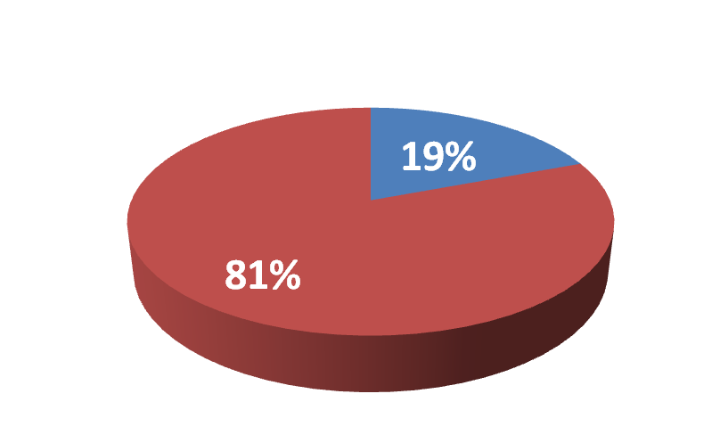
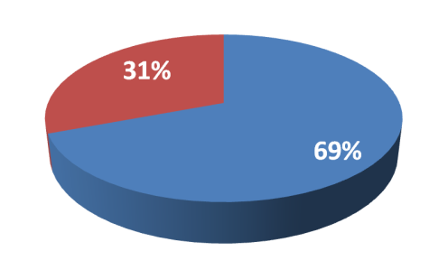
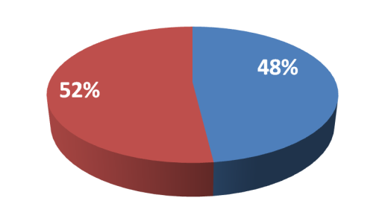
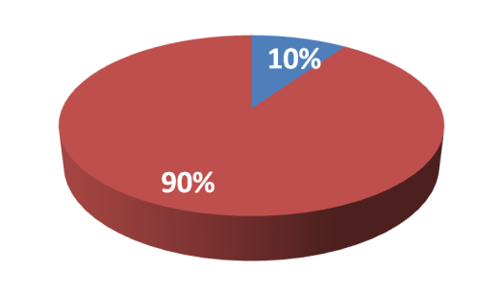
Spiritual Intelligence Test
Test Results
1. Spirituality is based on which of the following?
a) Experiencing a deeper knowledge of life.
b) Knowing the inner workings of God.
c) Reading lots of books on the subject.
d) Going to church religiously every Sunday.
2. What is karma?
a) A religion.
b) A motor vehicle.
c) A neutral energy.
d) The way god protects us.
3. Meditation brings us closer to God by doing what?
a) Opening our hearts and minds to the God flow.
b) Shutting out the outer world.
c) Keeping us in tuned with our inner spirit.
d) All of the above.
4. Why does soul exist?
a) Because God loves it.
b) To give us rhythm.
c) To test us in the physical world.
d) To make us stronger.
High SQ Low SQ

Slide 48
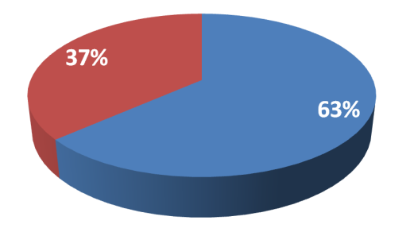
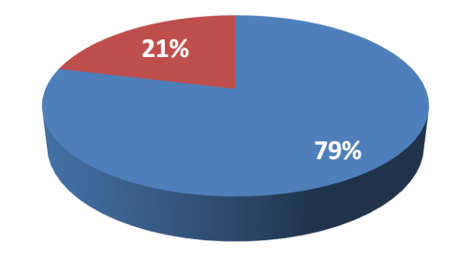
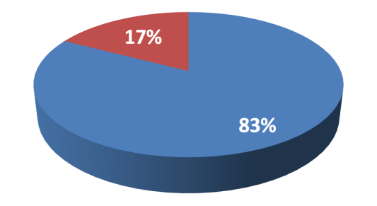
5. What is INTUITION?
a) A knowingness.
b) Something only a few of us have.
c) Intelligence.
d) A feeling of uncertainty.
6. People who have out-of- body experiences are what?
a) Usually deemed crazy.
b) Are dreaming.
c) Have a near death experience.
d) Get the opportunity to experience 'the other side.‘
7. A spiritual exercise can do which of the following?
a) Strengthen your inner spirit.
b) Cause an outer peacefulness.
c) Challenge your intellect.
d) Give you the tools to communicate with spirit.
High SQ Low SQ

Slide 49
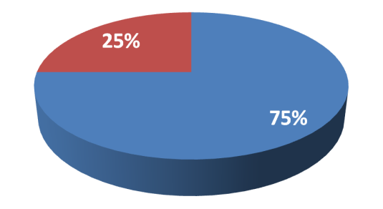
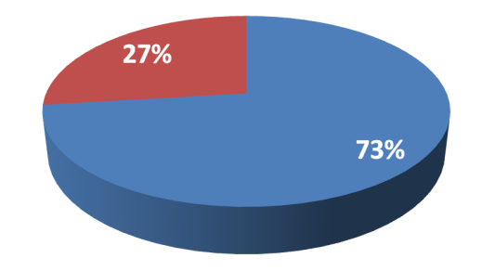
8. One way to increase your spirituality is by what?
a) Going to Bethlehem.
b) Going to Mecca.
c) Going without.
d) Going within.
9. The three greatest words you can say to someone is what?
a) I am sorry.
b) I forgive you.
c) I love you.
d) All of the above.
10. The phrase, 'Counting your blessings', refers to what?
a) Thanking everyone who matters to you.
b) Being grateful for what you have.
c) Something you do when you can't sleep.
d) Healing your heart.
High SQ Low SQ
Author: Alexis Harrison, writer and reporter print and televison news. She has worked for Fairfield Citizen-News and Fox News Channel in New York City

Slide 50
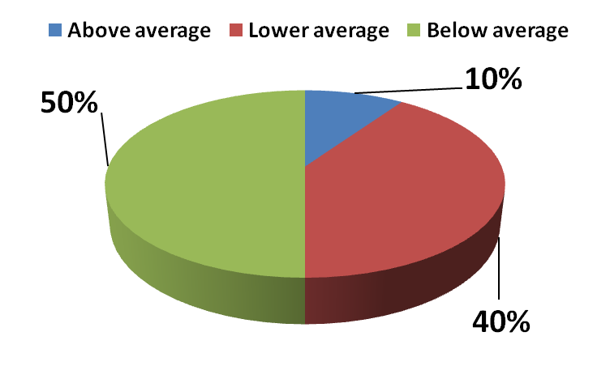
How to interpret test results?
Question | 1 | 2 | 3 | 4 | 5 | 6 | 7 | 8 | 9 | 10
High SQ | 19% | 69% | 48% | 10% | 63% | 79% | 35% | 83% | 75% | 73%
Low SQ | 81% | 31% | 52% | 90% | 37% | 21% | 65% | 17% | 25% | 27%
SQ | Subjects %
Above average | 10
Lower average | 40
Below average | 50

Slide 51
8. CONCLUSIONS
The development of spiritual intelligence in the workplace, especially in private, public administration and NGO:
struggle against: | determine:
stress | conflicts can be managed more easily and do not reach crisis
communicational handling, imagology manipulation, by and with the operation of the right hemisphere; in this case is essential to develop consciousness through transdiscilinarity and through –energetically and vibrational-informational approach, so that in Romania media manipulation are minimized | health improves

Slide 52
8. CONCLUSIONS
The development of spiritual intelligence in the workplace, especially in public administration:
struggle against: | determine:
physical aggression between people, groups and individuals within a family of groups (eg, between racial groups), between individuals, groups and communities, between nations, peoples and religions, between nations and alliances | ensure the energy balance of an organization and its internal stability
the hiding of economic al interests of many interest groups - for example, some of multinational companies, states etc. due to the drastic reduction under the earth's resources

Slide 53
The overall conclusion:
to have a spiritual life and be assiduously engaged in spiritual practice are authentic way guarantees mental health and human fulfillment
Characteristics of spiritual intelligence established by Frances Vaughan:
Intuition | Compassion
Contemplative knowledge propensity | The power to forgive
The ability of considering facts from several perspectives; refinement of perceptions | Aesthetic sensitivity and taste for beauty
Thinking freedom, reconsidering one’s own beliefs and conception upon reality | Humility
Spiritual pursuit and practice | Integrity, living one’s life according to the spiritual values and showing constancy in observing them
Discernment | Wisdom
Holistic approach | Cultivating authenticity and consciousness
Respect for all beings, approval of differences | Courage
The ability to love – receiving and giving love | Inner peace
Devoting oneself to the others under no pretence: kindness, generosity | Self confidence

Slide 54
8. CONCLUSIONS
Through transdisciplinary approach and the union of scientific levels of reality it could be obtained the most comprehensive reality, Unique Reality.
If we are what we think, even more than this, then we should learn in universities an algorithm or a method to eliminate perception errors by introducing a transdisciplinary way of thinking in order to improve the state of health of an employee, to lower the degree of stress of a civil servant in public administration, and for his balance, harmony and discovery of the Unique Truth.

Slide 55
8. CONCLUSIONS
We only have to follow consciously through the development of the consciousness of an emotional, attitudinal and behavioral balance, so that the efficiency in the workplace, but also during classes would increase substantially.
It is more and more necessary for a reanalysis and a rethinking of the training and perfectioning programmes organised by the public administration to happen. These should also include a new type of transdisciplinary training, which takes into consideration all the dimensions of the human being and which would help it 1. adapt more rapidly, 2. integrate more easily and 3. become harmonious with itself and the others, too.

Slide 56
8. REFERENCES
1. Antoine Lutz, Lawrence L. Greischar, Nancy B. Rawlings, Matthiew Richard şi Richard J. Davidson (2004) – Long term meditators self-induce high-amplitude gamma synchrony during mental practice – Proceedings of National Academy of Sciences of the United States of America (PNAS Sponsored), November 16, 2004, Vol. 101, no. 46, 16369-16373;
2. Părintele Arsenie Boca – Cărarea Împărăţiei in english The empire way - Romanian Ortodox Publishing House in Arad, Deva, ISBN 973-0-04456-2;
3. Braden, Gregg (2006) - Awakening to ZERO point - translated by Publishing House Editura for You in Bucharest, with the agreement of Hay House, Inc., 1999, in California, USA;
4. Brate, A. (2004) - Diagnoza multidimensională a stresului ocupaţional la manageri, Revista de psihologie organizaţională, vol. IV, nr. 3-4;
5. Daniel Cocoru (1981) - 20 sciences of XX century - Albatros Publishing House, Bucharest;
6. Covey, Steve, (2006) - A 8-a treaptă a înţelepciunii - De la eficienţă la măreţie, Editura Allfa, Bucureşti;
7. Dellor J., et all (1995), Treasure within, Report to UNESCO of the International Comission on Education for Twenti-first Century, UNESCO Publishing;
8. Emoto, Masaru (2009) - Forma iubirii. Cine suntem, de unde venim şi încotro ne îndreptăm, Editura Adevăr Divin, Braşov, Romania;
9. Emoto, Masaru (2007) - Miracolul Apei, Editura Adevăr Divin, Braşov, Romania;
10. Grigore, Ana, Maria (2009), Spiritual values-the path to moral capitalism,
Hyperion Journal, http://www.journal.universitateahyperion.ro/revistele/2/Volume%202,%20Issue%201,%202009.pdf;

Slide 57
11. Goleman, Daniel, McKee, Annie, Boyatzis, Richard (2007) - Inteligenţa emoţională în leadership, Editura Curtea Veche, Bucureşti;
12. Hall, Edward (1976) - The hiden dimension - Ed. Anchor Press, New York;
13. Hofstede, Geert (2001) - Culture’s consequences: Comparing values, Behaviors, Institutions, and Organizations Across nations - Sage Publications;
14. Iorga, Lucia (2007) - De la ateism la sfinţenie, Editura Elena Francisc Publishing, Bucureşti;
15. Marcus, Solomon (1988) - Provocarea ştiinţei - Seria „Idei contemporane”, Editura Politică, Bucureşti, Romania;
16. Marcus, Solomon (1966) - Lingvistica matematică - Editura Didactică şi Pedagogică, Bucureşti, Romania;
17. Mc Cartney, Francesca (2009) - Medicina intuitivă, Editura Mix, Braşov, ISBN 978-973-8471-84-9;
18. McShane, Steven L., Von Glinow, Mary Ann (2000) - Organizational Behavior, Editura Irvin McGraw-Hill, Boston;
19. Nicolescu, Basarab (1999) - Transdisciplinaritatea. Manifest - Editura Polirom, Iaşi, Romania;
20. Niţă, A., M. (2011) – Improving the knowledge through trans-disciplinary approach – EGPA 2011, PSG IX, Bucharest, Romania;
21. Niţă, A., M. (2010) - Schimbarea de paradigmă în managementul comunicării: nivelurile de realitate şi operare a minţii umane – Semiotics` Creativity – Unifying Diversities, Differences, Divides, 3rd International Conference of the Romanian Association of Semiotic Studies, Iaşi, Romania, 4-7 November, 2010;
22. Niţă, A., M. (2010) - Energetical and vibrational approach and the change in knowledge – Bucharest University, The International Conference on Administration and Business, ICEA-FAA, 4 – 5 JUNE 2010, http://conference@faa.ro, “Inter and Transdisciplinary Issues of Economic Behavior” workshop;

Slide 58
23. Niţă, A., M. (2009) – The influence of meditation upon mental and managerial activity – Universitatea Nationala de Aparare "CAROL I"-Bucuresti, 9-10 aprilie 2009, Sectiunea 13 - ACTIUNI ENERGO-INFORMATIVE, Editura Universitatii Nationale de Aparare "CAROL I", ISBN 978-973-663-722-3, pp 128-141;
24. Niţă, A., M. (2010) – Think it through (Pune-te pe gânduri) – Scientificaly educational research project Surviving by emotional intelligence, project financed by Constanta County in Romania together with a scientific documentary produced by NEPTUN TV televizion in Constanta city, Romania, direct link for episode 4, posted on YouTube: Nita Aurel Mircea Think it through, The Carnap s Paradox or the relativity of the truth, direct link http://www.youtube.com/watch?v=KnRXJlkIeYQ;
25. Niţă, A., M. (2006) - The role of mind and meditation in developing new abilities of taking decision – energetical and transdisciplinarity approach - ICELM-3, International Conference on Economics, Law and Management in Târgu Mureş, Romania, May 4th – 7th June 2006, Petru Maior University Publishing House;
26. Osho (2006) - Inteligenţa. Reacţionează creativ la prezent - Pro Editură şi Tipografie, Bucureşti, Romania;
27. Pitariu, H.D. (2004) - Stresul profesional la manageri: corelative ale personalităţii în contextul tranzacţiei socioeconomice din România, Revista de psihologie organizaţională, vol. II, nr. 3-4;
28. Riesman, Glazer şi D, 1953, apud Hofstede, Geert (2011) - Comparing values, Behaviors, Institutions, and Organizations Across nations, Sage Publications;
29. Ronecker, Jean-Paul (2006) - Vibrational energy of shape waves - Editura Pro Editura si Tipografie Publishing House, Bucharest;
30. Vaughan, Frances (2008) - What is spiritual intelligence, http://francesvaugh an.com/work1. htm, accessed at June 2011;

Slide 59
31. Vlăsceanu, Mihaela (1996) - Psihosociologia organizaţiilor şi conducerii, Editura Paideia, Bucureşti;
32. Zohar, Danah, Marshall, Ian (2011) - Inteligenţa spirituală, Editura Vellant, Bucureşti;
Enciclopedia pentru tineri Larousse – „Corpul omenesc” (1997), Editura RAO, Bucureşti, ISBN 973-98211-2-x;
33. www.pedagoogia3000.info;
34. http://egpaconference2011.org/documents/PSG9/NITZA.pdf;
35. http://egpa-conference2011.org/documents/PSG16/Nita.pdf;
36. http://www.braintrainer.vwi.ro/trainers.htm;
37. http://www.intuitionmedicine.com/academy/founder.htm;
38. http://www.totulpentrunoi.com/2011/01/minunile-d-nei-marioara-godeanu/;
39. http://www.formula-as.ro/1999/377/societate-37/societate-807;
40. http://www.acad.ro/com2003/pag_com03_1203.htm;
41. http://www.youtube.com/watch?v=1Bt4aXhLi6k&feature=related;
42. YouTube: Nita Aurel Mircea Think it through or YouTube: Nita Aurel Mircea Think it through or Management communication and emotional intelligence (English version);
43. YouTube: Nita Aurel Mircea Pune-te pe ganduri (Romanian version);
44. Realitatea TV in Romania, Evening News from 20 hours, 22 of May 2012;
45. Interview with SRI VASUDEVA, engineer, teacher and specialist in human resources management, councieller, consultant in leadership and stress management, director of Complementary Therapeutical Center in Trinidad & Tobago – Caraibean Islands, May 2009;.
46. Interview with Lama TANPAI Rinpoche Acharya, spiritual master born in Tibet; in our days is the founder of White Royal Monastery in Katmandu, Nepal, February 2007 and 2008, Bucharest 2010.

